Slide 1

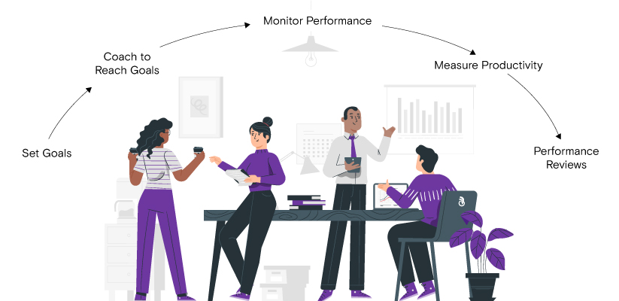
3. Performance Appraisal
HRMS Training

Slide 2
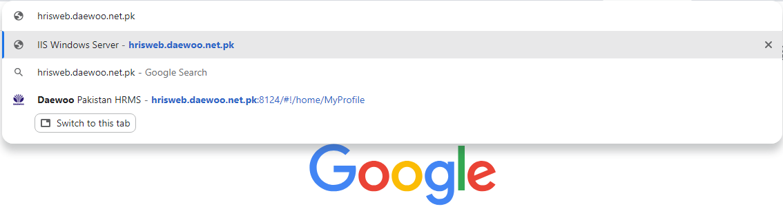
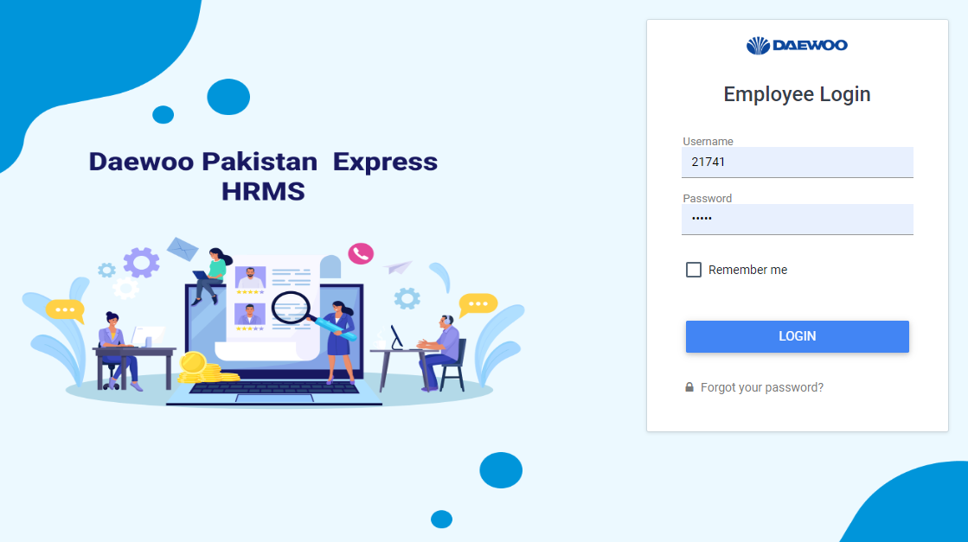
STEP 1
Open Google Chrome. Enter the URL
hris.web.daewoo.net.pk
STEP 2
Enter your Login Details
(Employee username &Password) to login to your profile

Slide 3
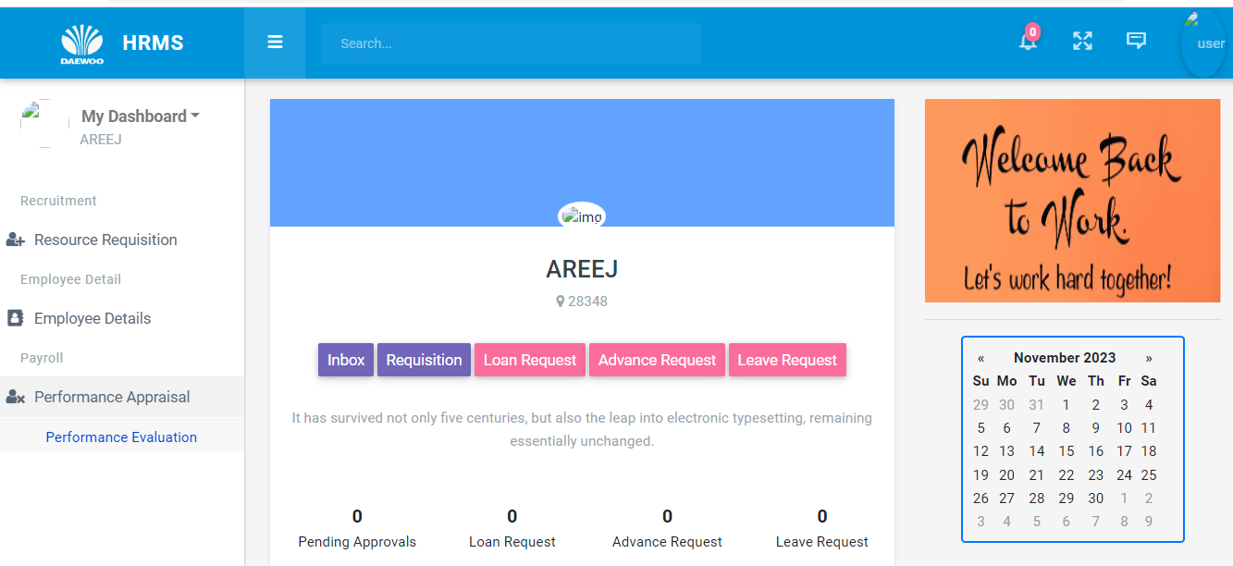
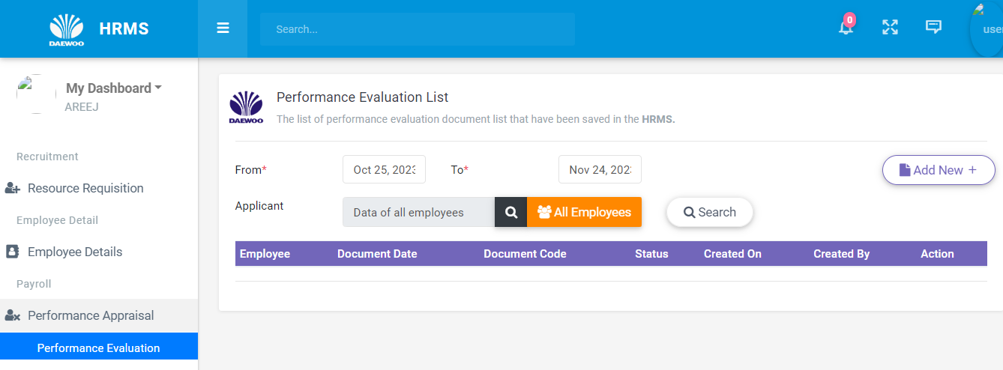
Homepage will appear
STEP 3
On Left side of homepage, click Performance Appraisal, then Performance Evaluation
STEP 4
Click ADD NEW
This page will appear

Slide 4
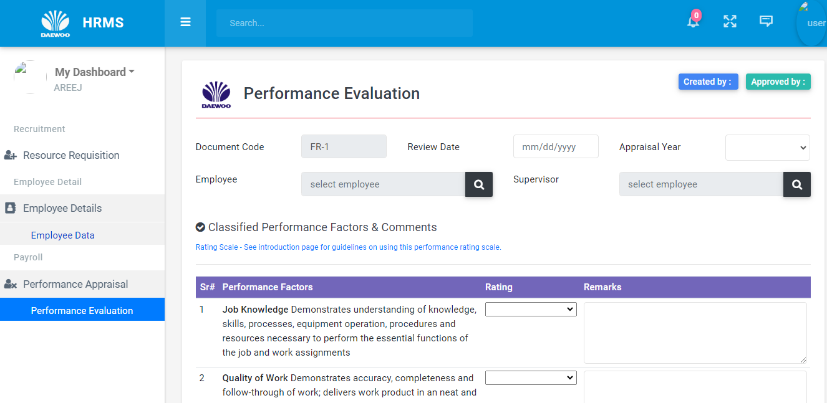
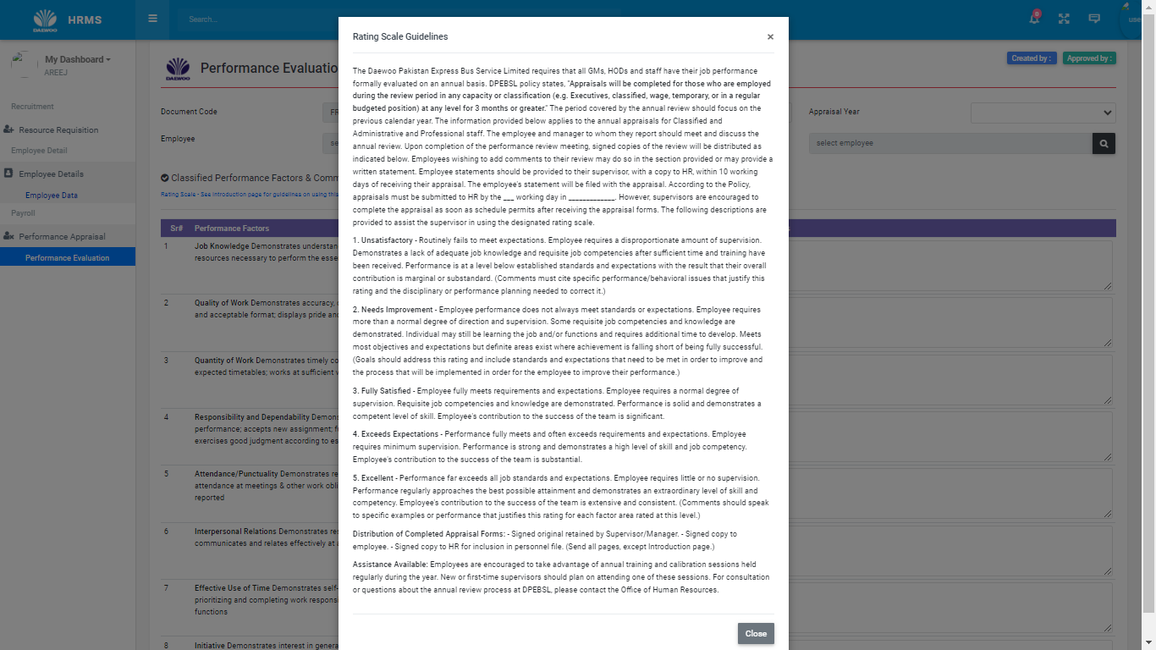
STEP 5
This page will appear
Enter all relevant Information like Employee code, Name, Supervisor, appraisal year in this section
When you click this Rating Scale Guidelines will pop up & you’ll see all criteria or rating

Slide 5
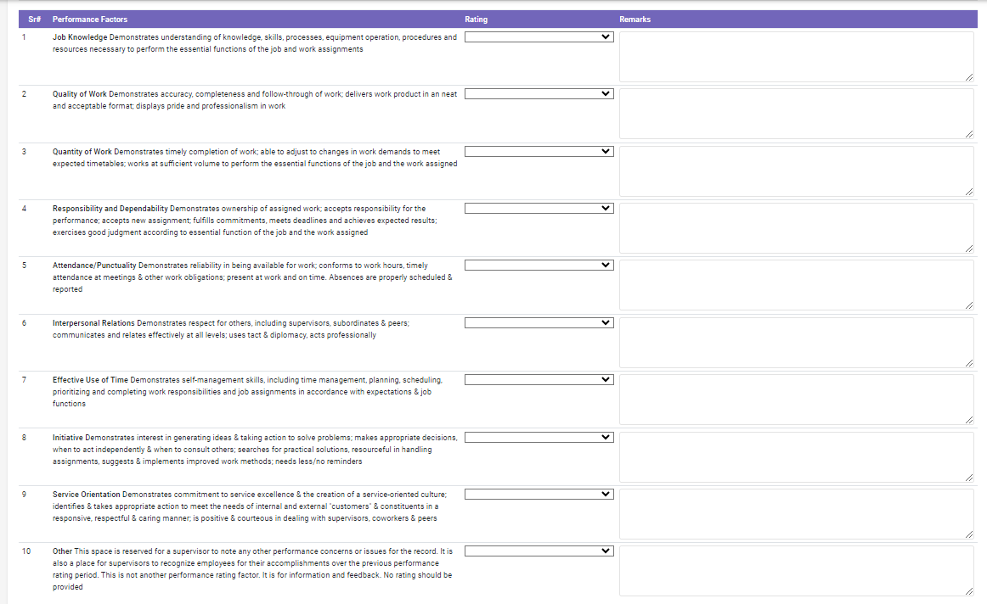
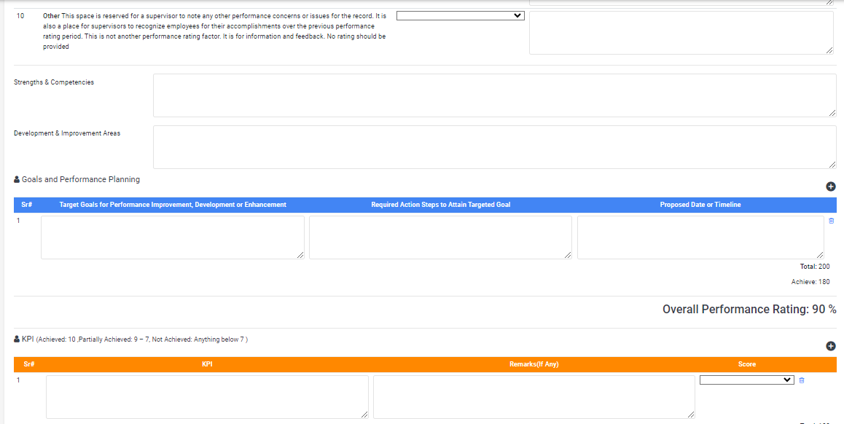
STEP 6
When you scroll it down 10 performance factors along with their Ratings & Remarks pop up
Mark each factor according to performance of employee with remarks
STEP 7
On further scrolling you’ll see sections Strengths & Competencies
Development & Improvement Area, Goals and Performance Planning & KPI’s. Fill each Section
accordingly

Slide 6
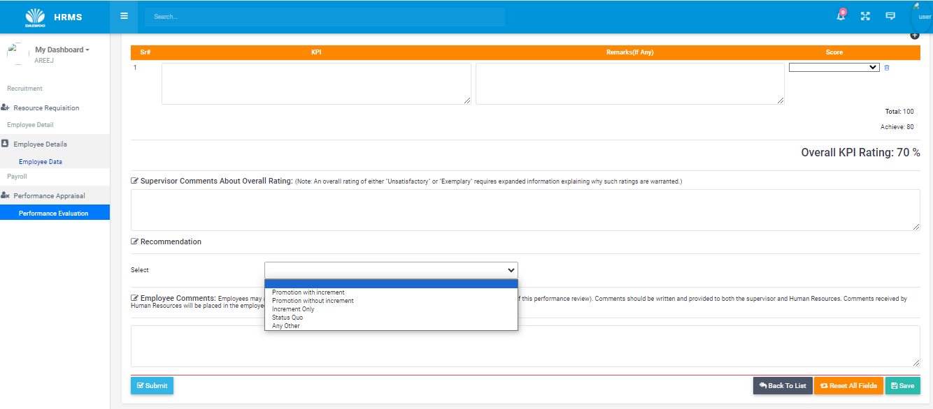
STEP 8
Under this, you’ll see Recommendations sections, below this Click SELECT, 4 options will pop up
Among the all 4 options, select the most relevant to your employee’s performance

Slide 7
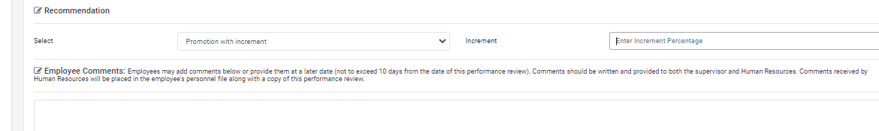
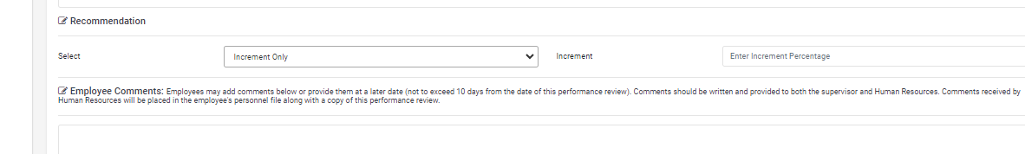
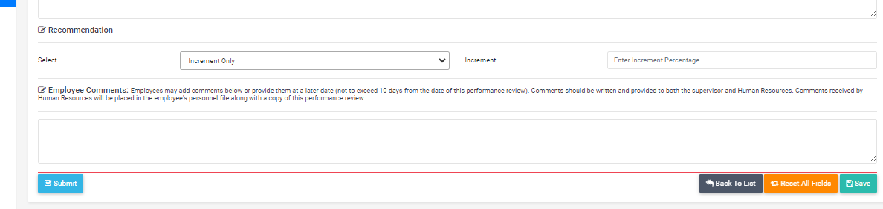
STEP 9
In case of PROMOTION WITH INCREMENT & INCREMENT ONLY , you must enter Increment %age
STEP 10
In last section of page, you’ll see Employee comments, Make sure to write employee’s feedback on their appraisal sheet
STEP 11
In the end , on right you’ll see various options SAVE, RESET, BACK TO LIST & on left you’ll see Submit.
Choose options carefully, Remember you can’t edit after Submission.

